Slide 1
Families as Partners in State Policy
February 26, 2021

Slide 2
Today
Closed captions
Q & A
Survey
Certificate
Recording

Slide 3
Learning Objectives
Raise awareness of the unique concerns and issues of families who have a member with autism.
Gain understanding of most effective ways for families to share their issues and concerns with Ohio legislators.
Identify key points in the legislative process and key people for families to talk with.

Slide 4
IWGA Members
Ohio Department of Developmental Disabilities (DODD) – Lead Agency
OCALI – Convener
Ohio Department of Education (ODE)
Ohio Department of Health (ODH)
Ohio Department of Job and Family Services (ODJFS)
Ohio Department of Medicaid (ODM)
Ohio Department of Mental Health and Addiction Services (OMHAS)
Opportunities for Ohioans with Disabilities (OOD)

Slide 5
Pursuing Quality Lives 2020
Get a good start: early identification and diagnosis
Obtain needed services: access to high quality services
Develop skills to succeed: skill development across the lifespan
Strengthen support along the way: family
Help others understand: community awareness
Live well: navigating community resources
Sustain the future: planning and coordination

Slide 7
Why autism?
Families of children with autism are more likely to:
Reduce their work hours to care for their child (30%) - compared to 12% of parents of children with other special health care needs (SHCN) and 2% of parents of children with no SHCN
Experience material hardship than parents of children with other SHCN and parents of children with no SHCN. Parents who are black or Hispanic experience the highest levels of material hardship.

Slide 8
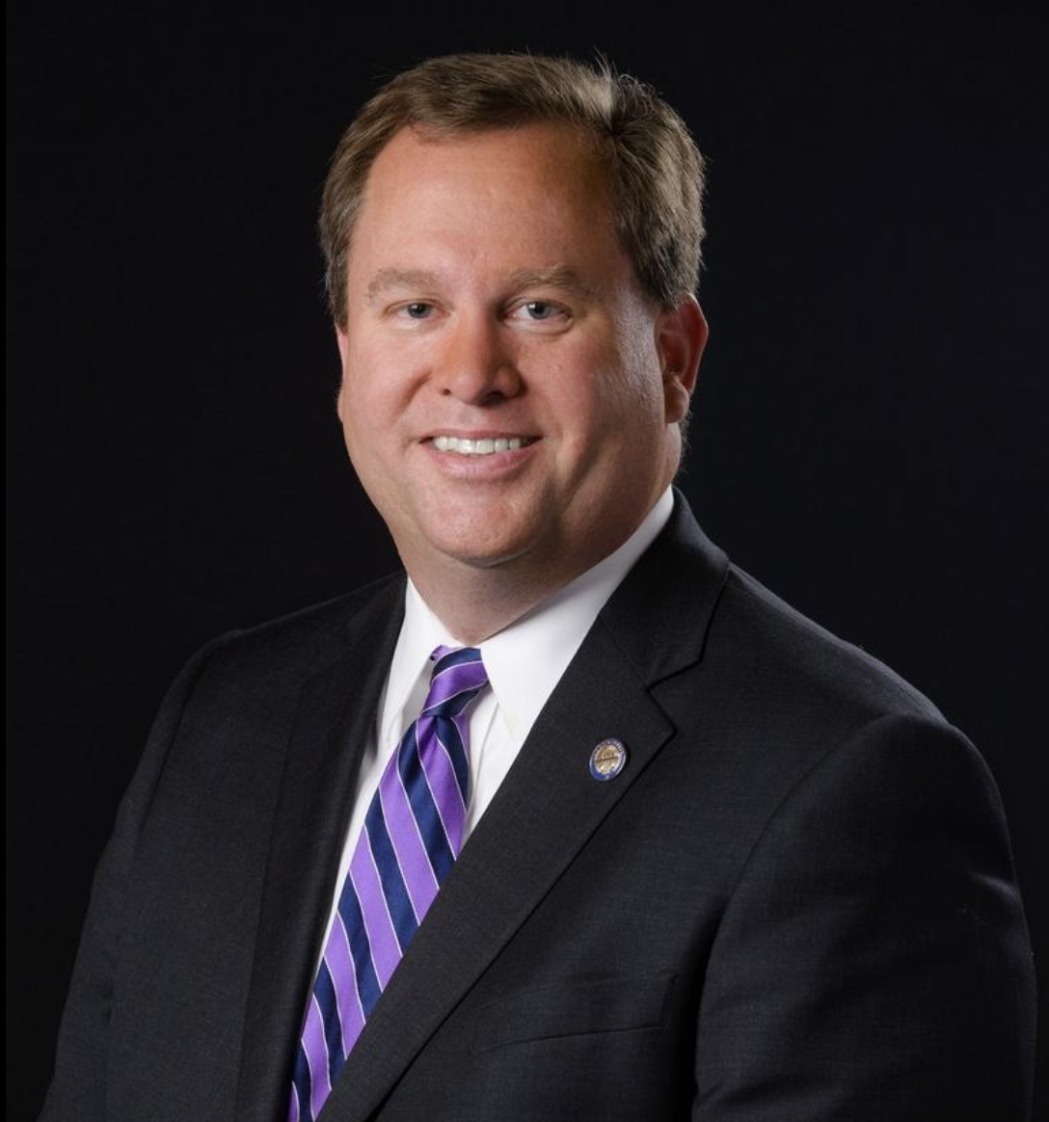
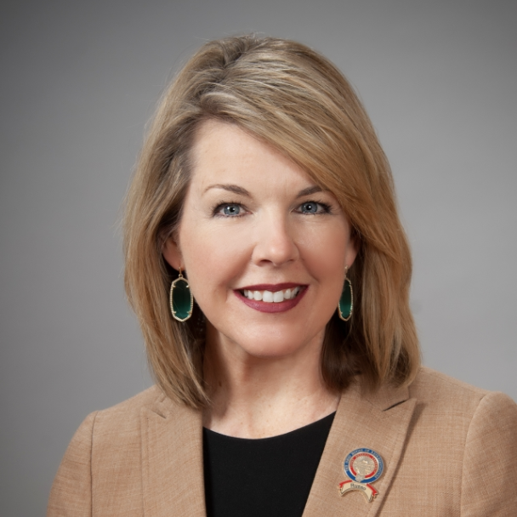
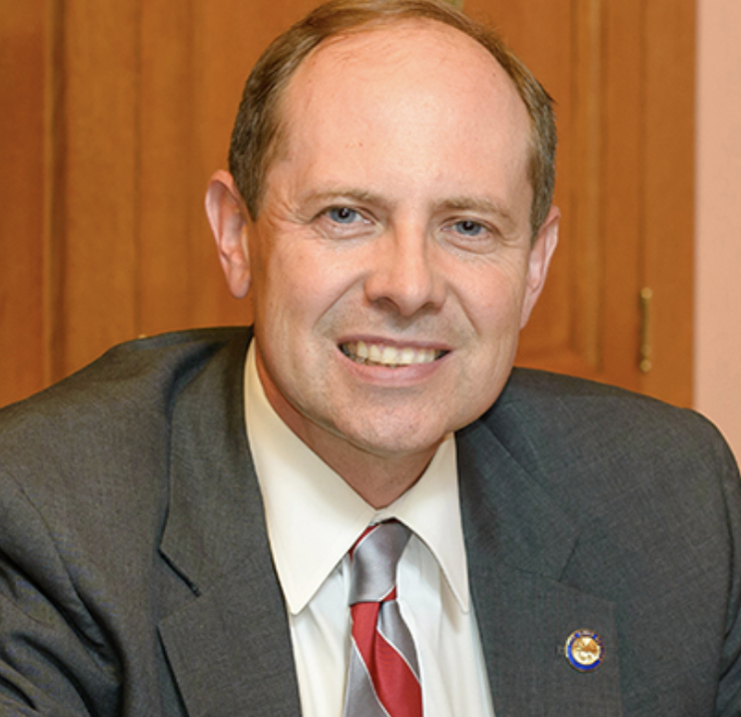
Kevin Bacon, parent
Representative Russo
Senator Hottinger
Mike Hartley, parent

